Slide 1
TYPES OF BUSINESS LETTER

Slide 2
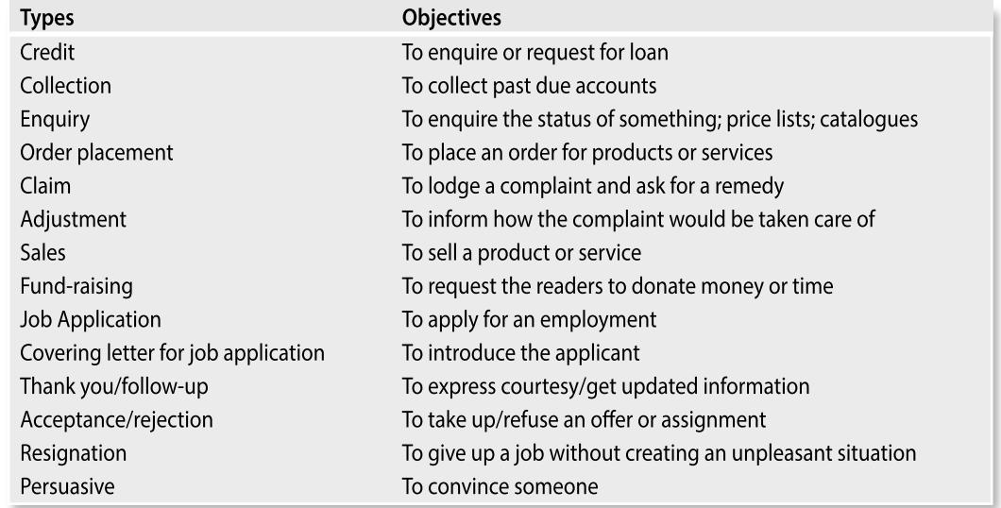

Slide 3
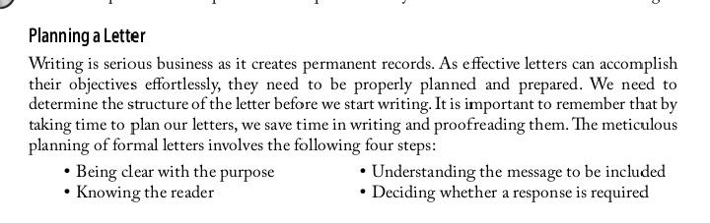

Slide 4
CREDIT LETTERS

Slide 5
Credit Letters
Credit means that we pay later for what we buy now. Goods are sold on credit to increase profit, as it encourages people to buy more.
The different types of credit letters include (a) requests for credit, (b) status enquiries, and (c) replies to status enquiries.

Slide 6
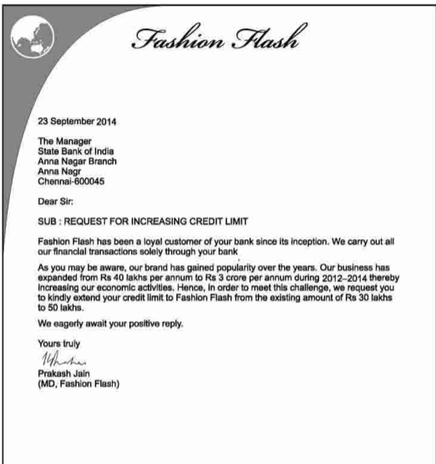
Letters requesting for credit
There are two types of letters in this category—request for enhancing credit limit and request for enhancing the credit period.

Slide 7
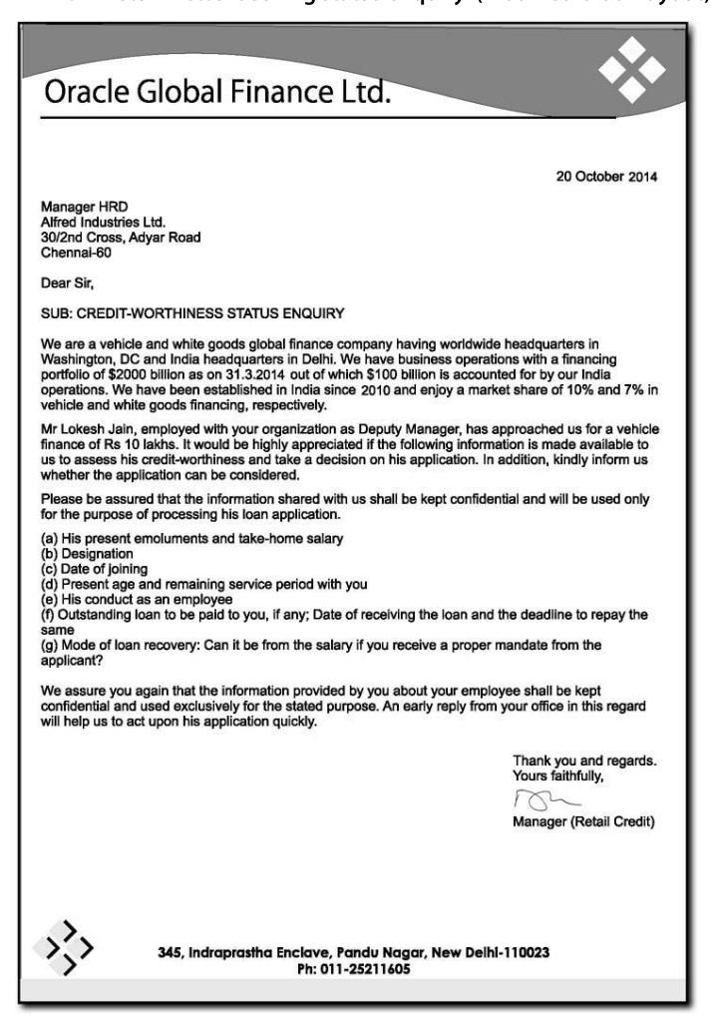
Credit Status Enquiry Letter - When clients apply for credit, the finance company needs to check upon their credit worthiness to ensure that it does not incur losses owing to bad debts (credit that is not paid back).
• Seek general information about the applicant.
• Assure that the information provided will be kept confidential.

Slide 8
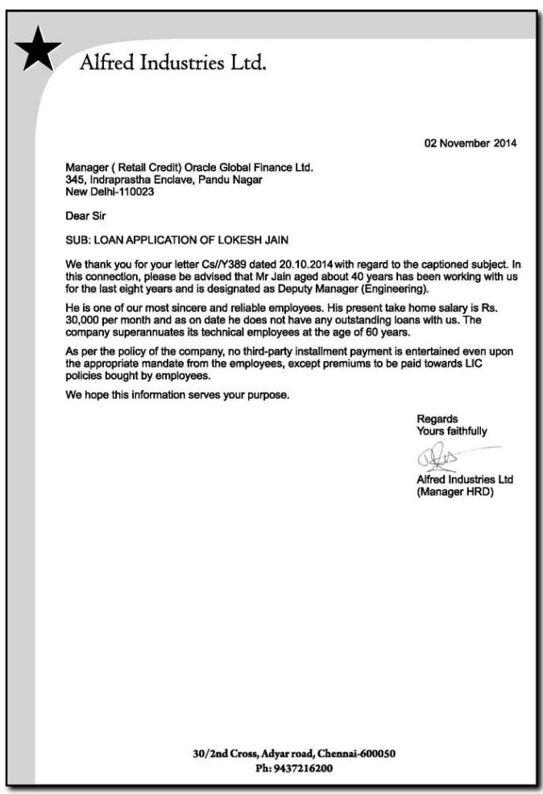
Reply to a Status Enquiry When the reply to the status enquiry about the credit of an individual or firm is positive, the reply is simple and faces no difficulty in writing. However, if the case is uncertain, care needs to be taken while responding.

Slide 9
LETTERS OF INQUIRY

Slide 10
Letters of Inquiry
A letter of inquiry asks someone for specific information. In some cases, such as a request for promotional material, the recipient will have a clear interest in responding to your letter. In other cases, such as a request for specific information on a product, the recipient may or may not be as motivated to respond quickly. Consequently, always make the tone of the letter friendly and make it easy for the recipient to identify and provide the information you need.
An enquiry letter is useful when we need information, advice, names, or directions. However, avoid asking for too much information or for information that could easily be obtained in some other way, for example, by a quick search on the Web.

Slide 11
Format of a Letter of Inquiry
In the first paragraph, identify yourself and, if appropriate, your position, and your institution or firm.
In the second paragraph, briefly explain why you are writing and how you will use the requested information. Offer to keep the response confidential if such an offer seems reasonable.
List the specific information you need. You can phrase your requests as questions or as a list of specific items of information. In either case, make each item clear and discrete.
Conclude your letter by offering your reader some incentive for responding

Slide 12
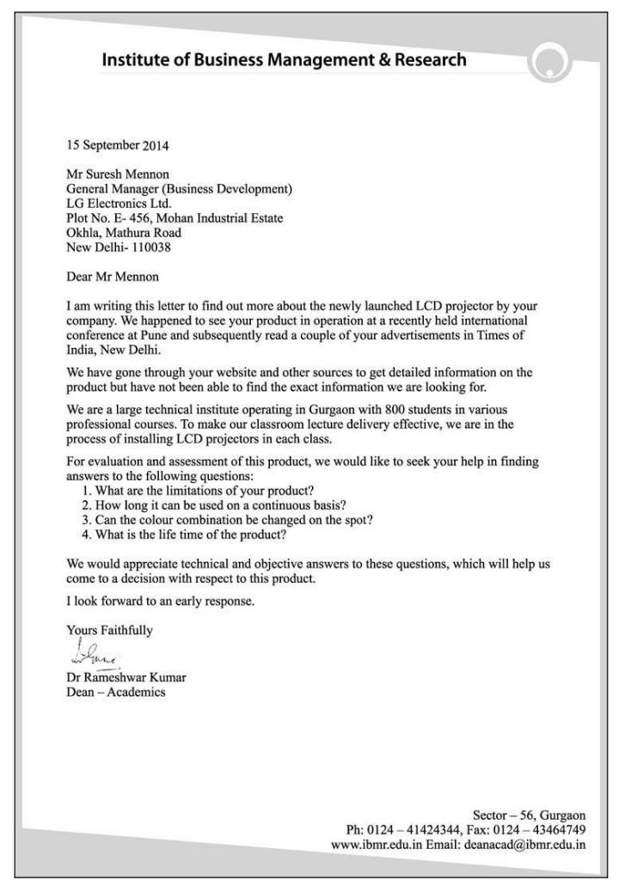
Solicited letters of enquiry are written when a business or agency advertises its products or services. For example, if a software manufacturer advertises a new package developed and it cannot be inspected locally, we can write a solicited letter to that manufacturer asking specific questions.

Slide 13
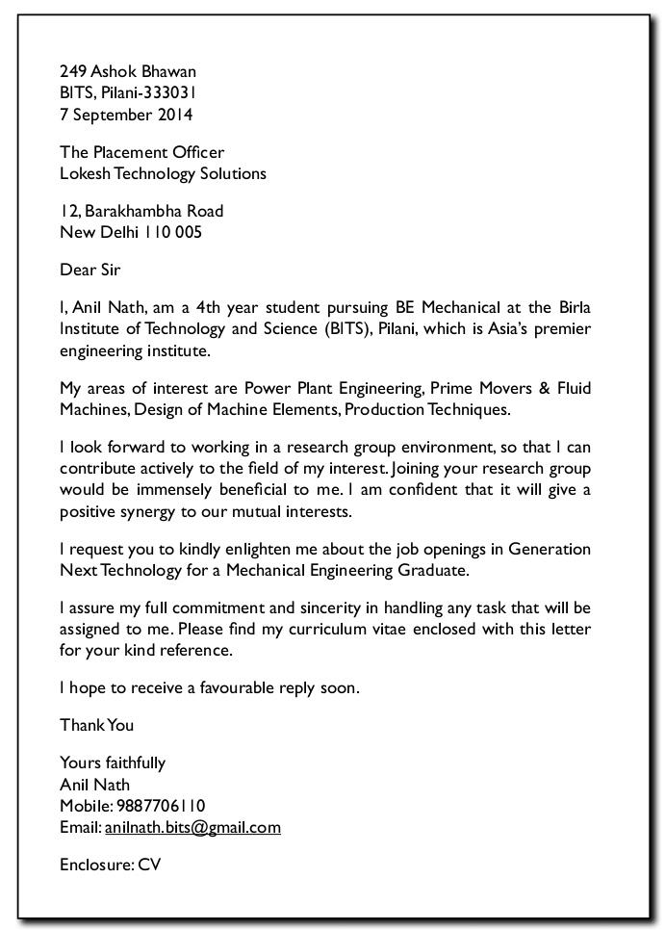
A letter of enquiry is unsolicited if the recipient has not prompted the enquiry. For example, if we read an article by an expert, we may have further questions or want more information.

Slide 14
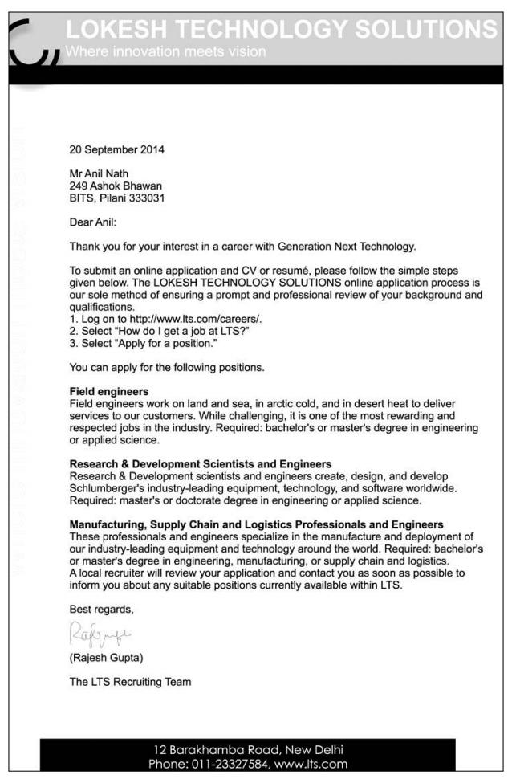
Reply to Unsolicited Letter Letters of enquiry must be replied to promptly to maintain healthy and pleasant business relationships. If the enquiry is from an established customer, appreciate their effort. If the enquiry is from a prospective customer, let your reply reflect that you are glad to receive the enquiry and express the hope that this new relationship will last long.

Slide 15
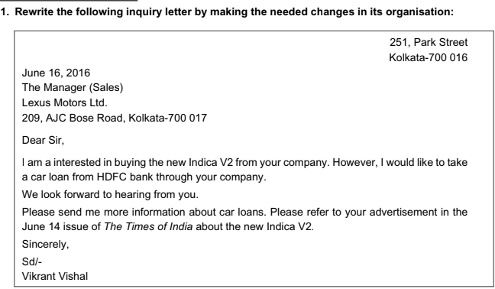

Slide 16
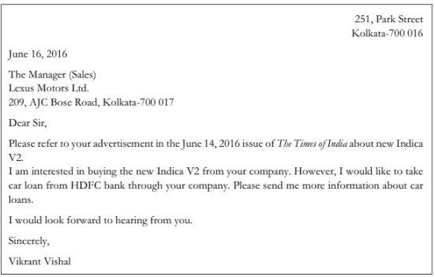

Slide 17
COMPLAINT LETTER

Slide 18
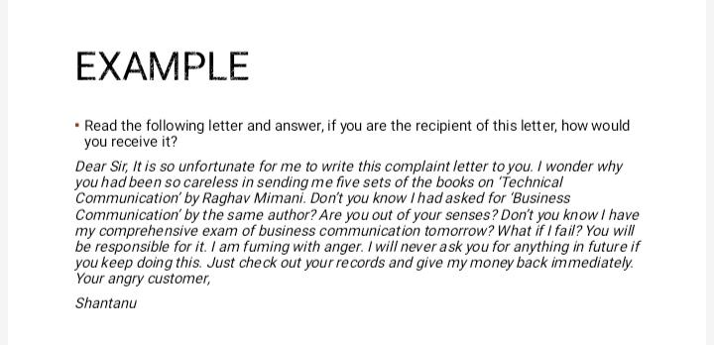

Slide 19
Complaint Letter
The complaint letter should be written in the business letter format. When writing a complaint letter you want to keep it short and to the point to help ensure that your letter will be read in its entirety, if you write a seven-page complaint letter, it’s highly unlikely that someone will sit down and read all seven pages. The complaint letter should be addressed to the customer service/consumer affairs department or the head office if there is no customer service department. The address and contact information of the customer service department should be available on the company’s products or website.

Slide 20
Claim Letters A claim (a formal complaint) or an adjustment request (a claim settlement) is made when a company’s product or service is not satisfactory. Although a complaint could be lodged over telephone, we may like to document the complaint, as the written word always has a greater value than the spoken word, and serves as a permanent record for future reference. A courteous, clear, concise explanation will impress much more favourably than an abusive, angry letter. Objectives: • To bring the mistake/fault to the notice of the supplying company. • To rectify the mistake either by repair or replacement.

Slide 21
A complaint letter can be written for any of the following reasons: • Billing errors • Goods not matching the sample • Damaged goods • Difference in agreed prices • Wrong goods • Late delivery • Wrong quantity • Non-delivery • Unsatisfactory quality • Poor service

Slide 22
Guidelines to remember while writing a claim letter 1. Provide a reference point, namely, consignment number/invoice number, date, and items ordered either in the beginning of the message or in the subject line. 2. Explain the problem clearly and give specific details. 3. Briefly explain the inconvenience/difficult situation being faced because of the problem. 4. Appeal to the supplier’s reputation and sense of responsibility and fairness. 5. State clearly as to what action is required or what adjustment is expected from the supplier. 6. Mention the relevant documents being enclosed with the letter and also your availability for receiving the corrected consignment.

Slide 23
First Paragraph
You should identify what the issue is and any relevant information that you believe is important. Be sure to include the following information if it's applicable to the situation: the date/time of the issue, location, name of person on duty, name of product, what the problem was, your account number, model number, price, warranty information and reference number. Be sure to stick with the facts and avoid putting emotions into your letter.
I have recently ordered a new pair of soccer cleats (item #6542951) from your website on June 21. I received the order on June 26. Unfortunately, when I opened it I saw that the cleats were used. The cleats were dirty and there was a small tear in front of the part where the left toe would go. My order number is AF26168156.

Slide 24
Next Paragraph
State what you would like done to resolve the situation. If you received poor service, you could request an apology or a coupon. If a product malfunctioned, you could request that you could exchange the product for a new one or request a refund.
To resolve the problem, I would like a credit to my account for the amount charged for my cleats, I have already purchased a new pair of cleats at my local sporting goods store so there is no need to replace the defective cleats.

Slide 25
Last Paragraph
Thank the reader for the time. You can also throw in some compliments about something you liked about their company’s product or service.
Thank you for taking the time to read this letter. I have been a satisfied customer of your company for many years and this is the first time I have encountered a problem. If you need to contact me, you can reach me at (555) 555-5555.

Slide 26
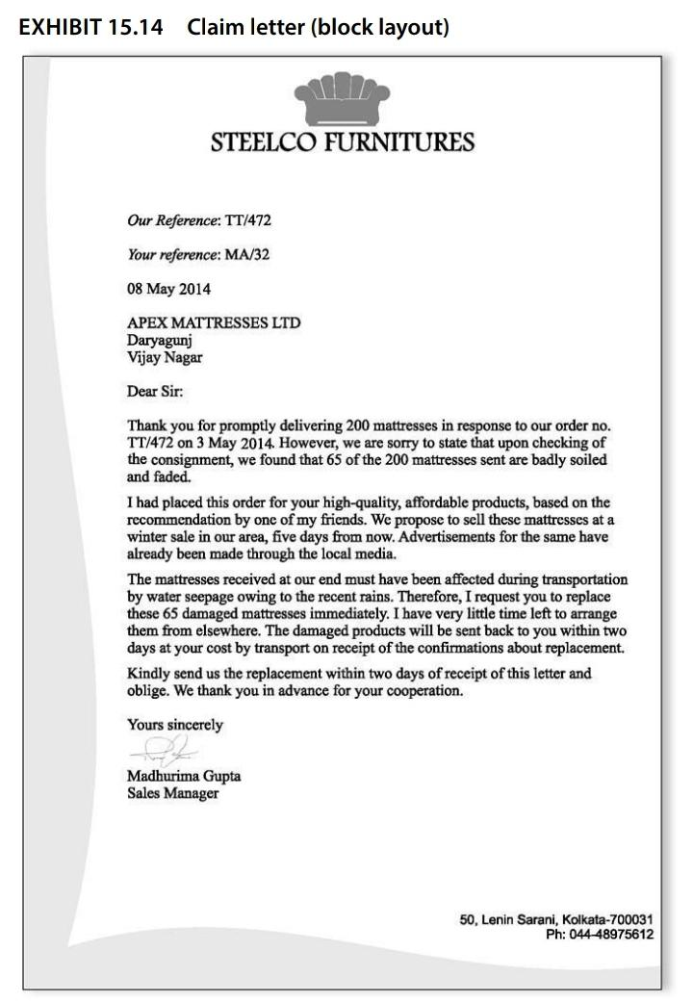

Slide 27
